Slide 1



PRESENTATION
Medical
Website
By / Karim Abdelhalim
Omar Hamdy

Slide 2
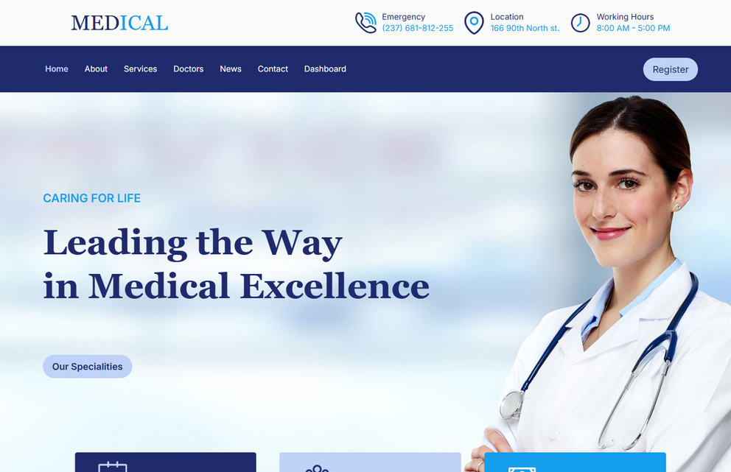


Introduction
Welcome to Medical Website. This platform was developed to provide a comprehensive online solution for healthcare services. It allows patients to easily book appointments, access information about doctors and medical specialities, and stay informed with the latest medical news. The website is designed to be scalable, secure, and user-friendly. Our goal is to streamline healthcare interactions for both patients and administrators.

Slide 3



Tools
Next.js, Tailwind Css, TypeScript, shadcn ui
Node.js, Express.js
MongoDB
Front-end
Back-end
Data storage

Slide 4
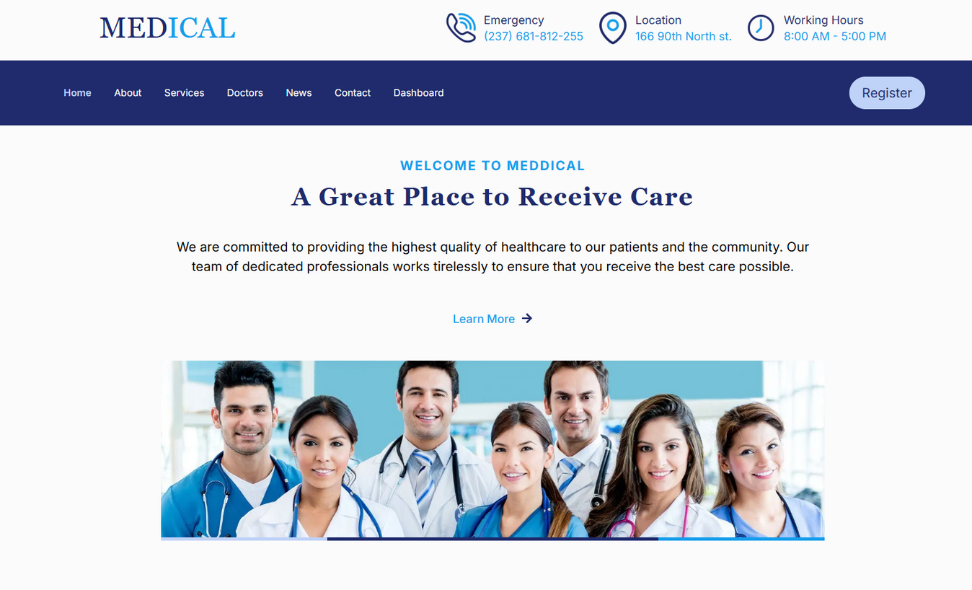


Home
User-friendly design
Quick links
Fully responsive

Slide 5
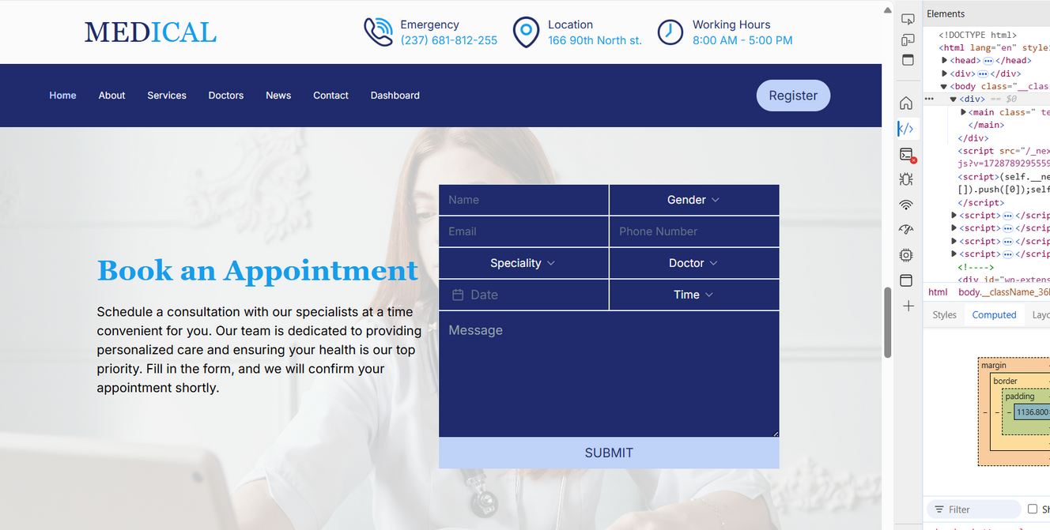
Appointment
Patients can easily schedule appointments online.
Calendar displays available time slots.
Users can filter doctors by speciality

Slide 6
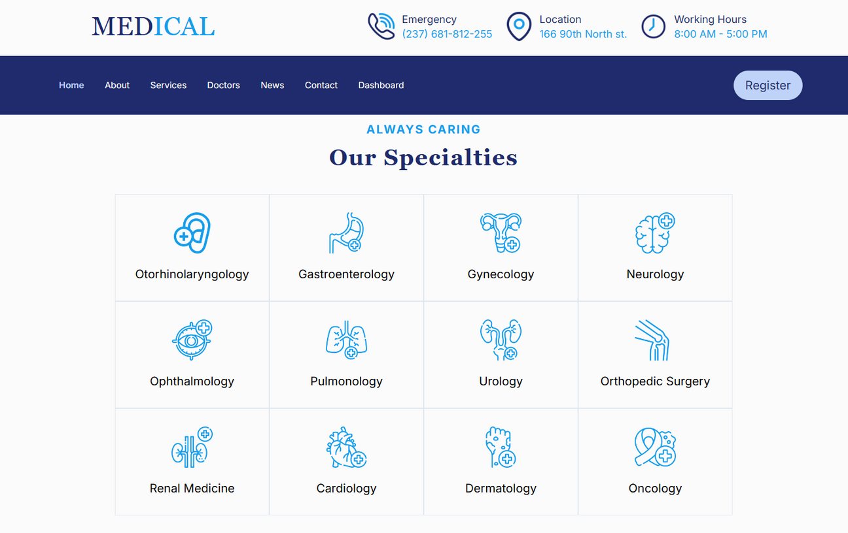


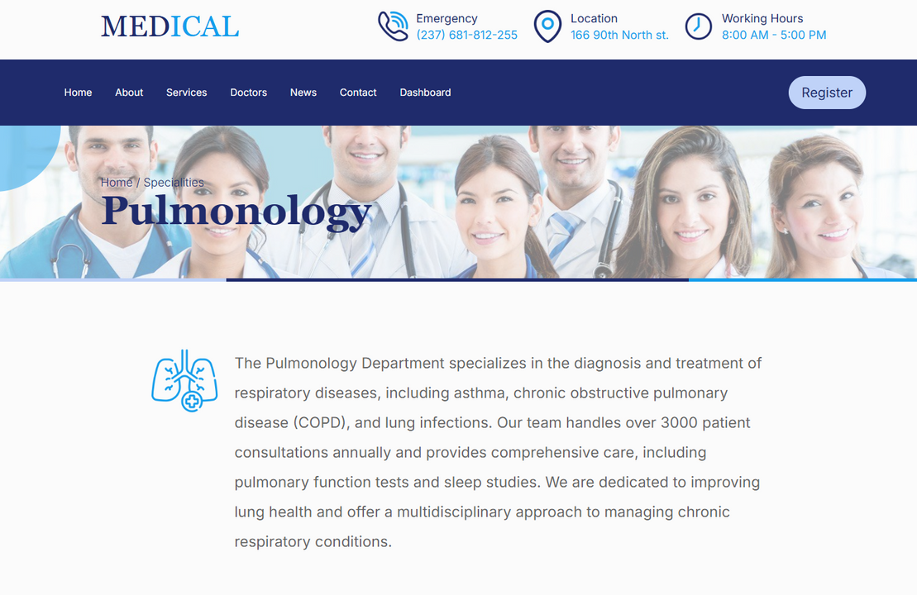
Specialities
Main section
List of medical specialities.
Each speciality links to expert doctors in the field.
Service page
Details about the speciality
Best specialist doctors

Slide 7
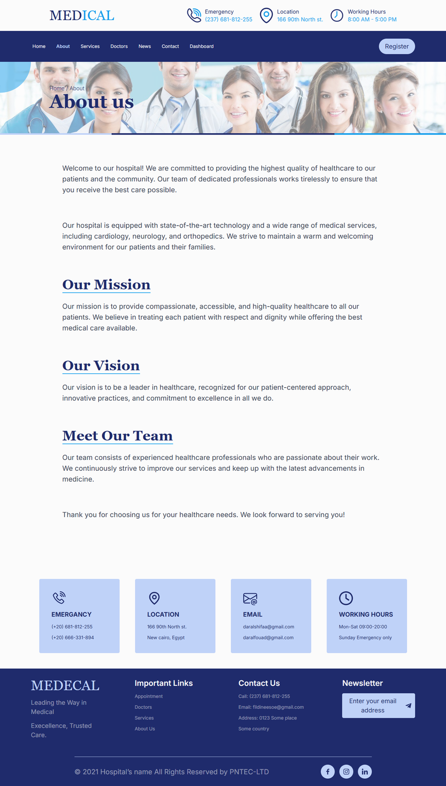

About us
Mission and values of the medical institution.
Introduction to the medical team and their expertise.

Slide 8
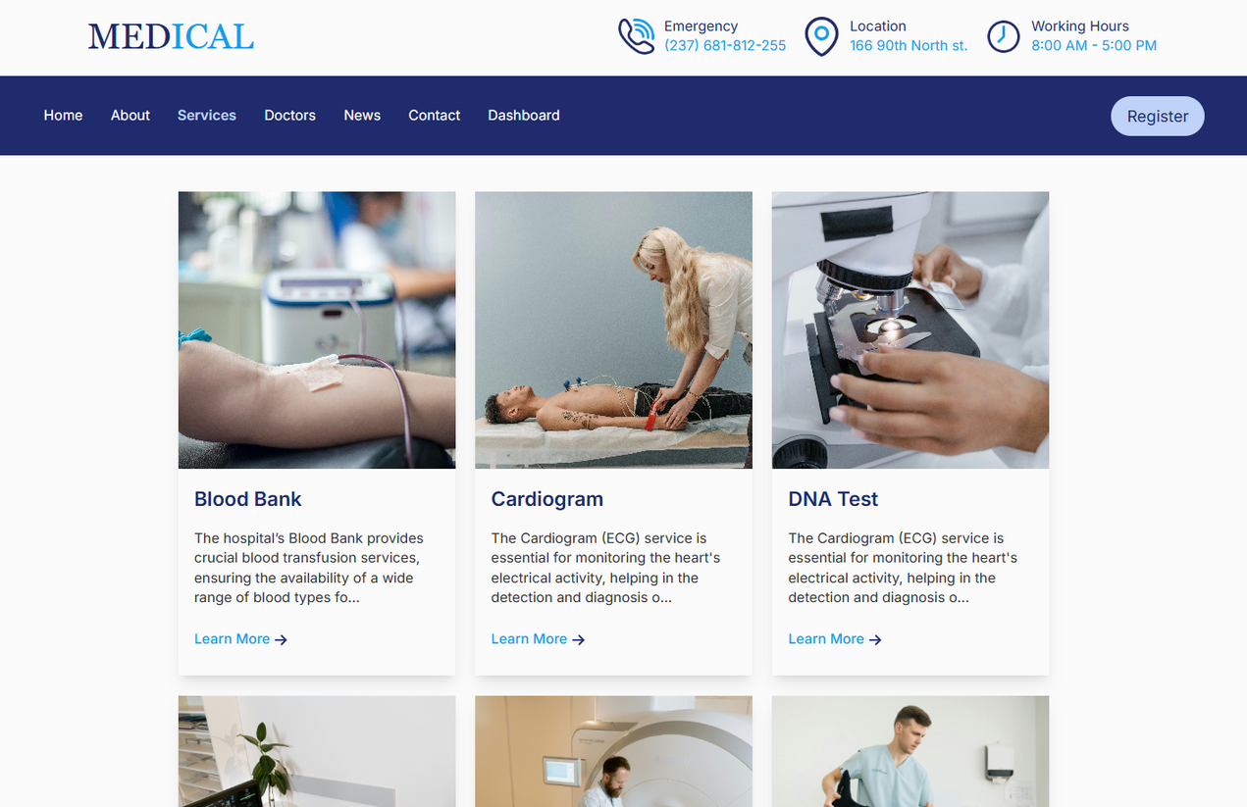

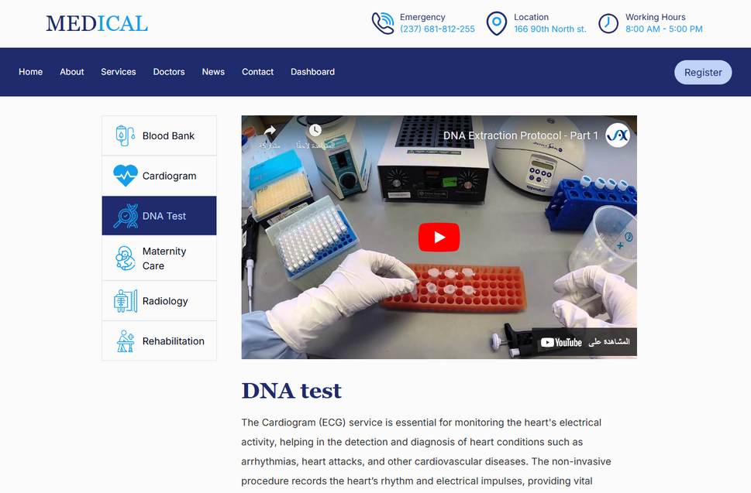
Services
Main page
Detailed information about healthcare
services.
Service page
Includes videos for better understanding.

Slide 9
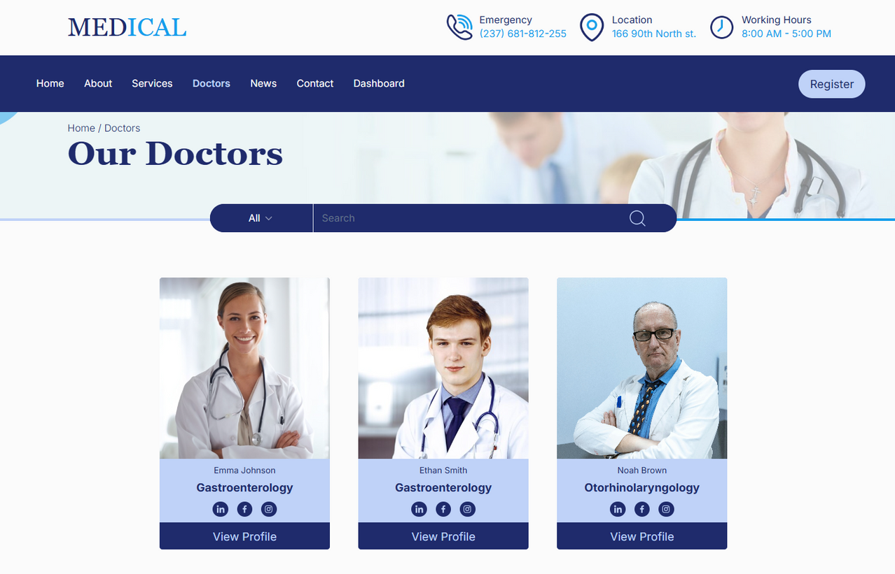

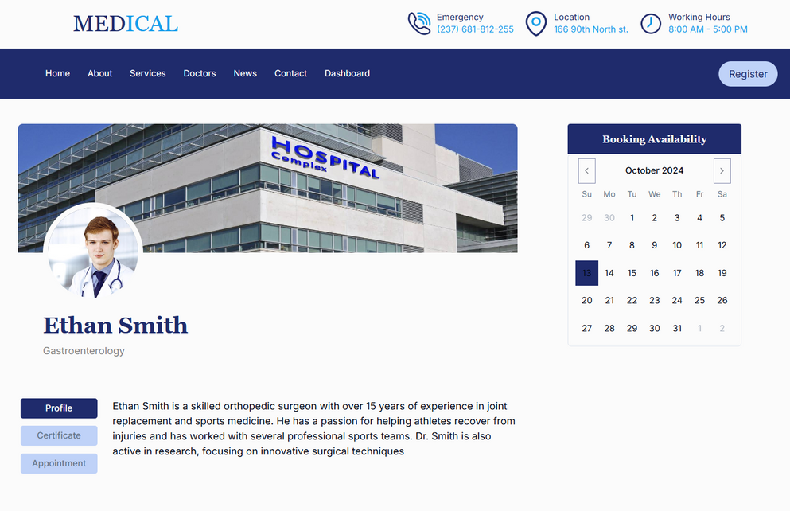
Doctors
Main page
Display list of doctors with their specialities
Easy search functionality name.
Specialities filter
Doctor page
Users can view detailed profiles of doctors.
Includes the doctor’s certificates.
User can make an appointment with the doctor

Slide 10
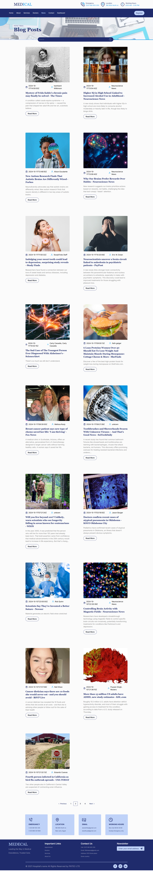
Blogs
Regular updates on medical news.
Keeps users informed.
Contains pagination to switch pages
Contains search by article title

Slide 11

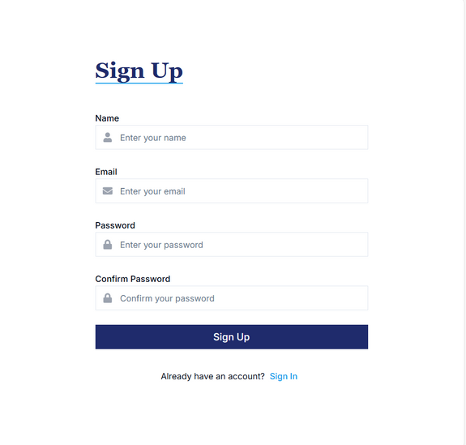
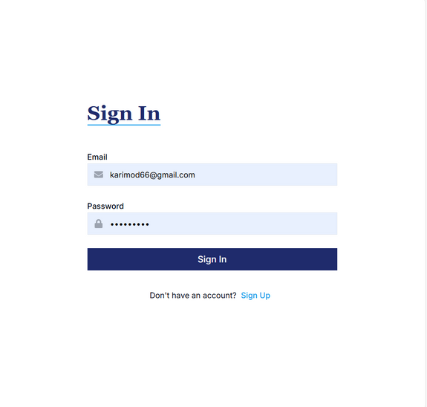

Register
Simple registration form for new users.
Secure user data storage using MongoDB.

Slide 12
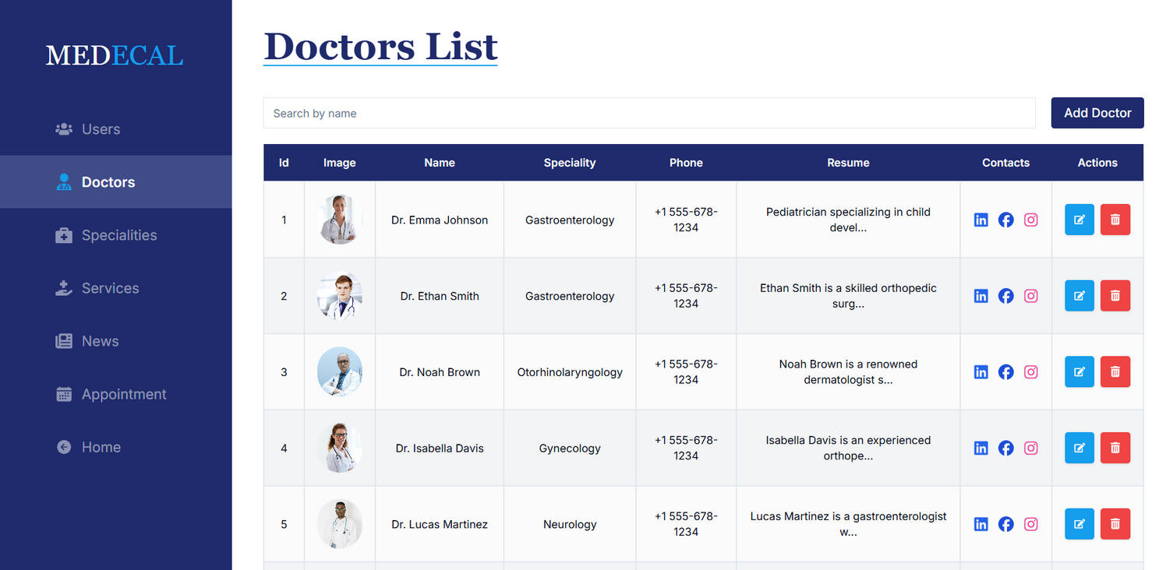
Admin dashboard
Manage doctors, specialities, and services.
Add, edit, or remove content.
Monitoring users & appointments
Easy content management system.

Slide 13




Conclusion
Project goal
Achieved
Future improvements
Build a scalable, user-friendly medical platform.
Fast, secure, and easily manageable solution.
Live chat, AI-powered consultations.
04

Slide 14

Thank
You.
For Your Attention

